Slide 1
Altar Server Training
Refresher and New items for Advent and beyond

Slide 2
Topics Discussed
Creedence table setup
Altar setup
Postures at Mass
Candles
Where to stand
New bell ringing procedures
New end of Mass procedures

Slide 3
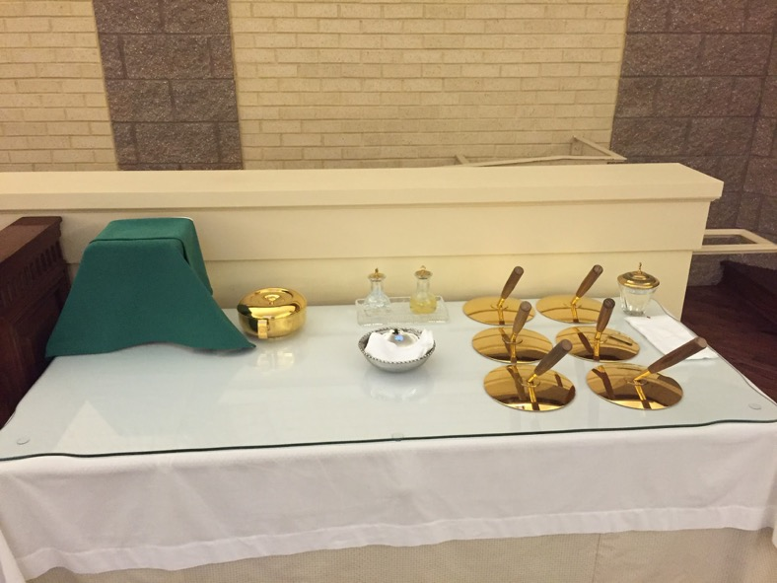
Creedence Table Setup
Things to note:
The Chalice is on the left side of the table. The front of the chalice (the side with the cross or embroidery if there is one) faces the altar
The Ciborium (with unconsecrated hosts) if needed goes to the right of the Chalice
The Cruets (with water and wine) go to the right of the Ciborium. On a Weekend Mass, the wine may be in the back of the church to be brought up during the mass with a Ciborium
Lavabo and towel in front of Cruets

Slide 4
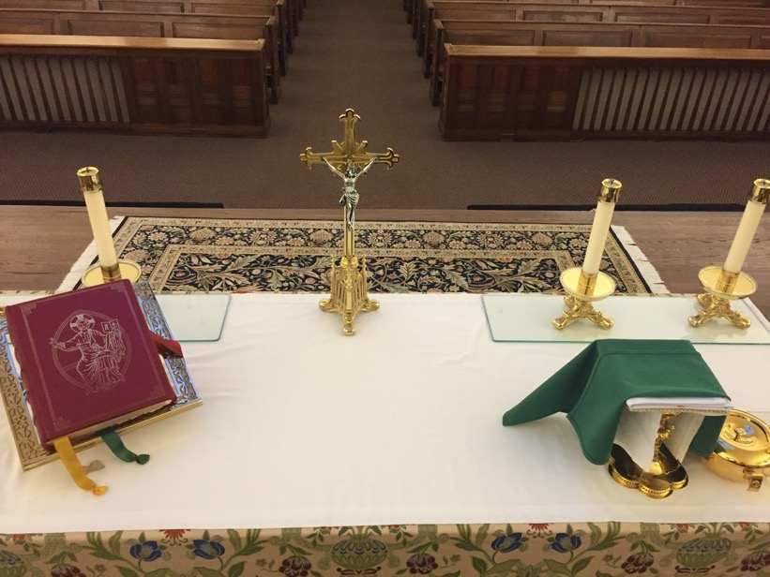
Altar Setup
The Missal (the Book) goes to the left of the Crucifix
The Chalice is placed on the right of the Crucifix, to the left of the sheet under the plexiglass.
The Chalice is placed with the front facing the Crucifix. The Crucifix on the base of the Chalice is facing the Celebrant
The Ciborium (if needed) will go on the plexiglass

Slide 5
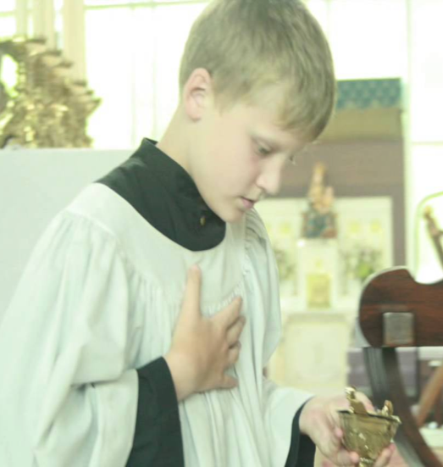
Postures at Mass
Hands: unless you are carrying something, your hands should be kept in front of your chest, palm to palm, fingers pointing upward. If you are carrying something in your right hand, your left hand should be held flat on your chest.

Slide 6
Postures at Mass
Eyes: always look where the action is: at the altar, the pulpit, chair, as the Mass moves along.
Standing: always stand up straight with both feet firmly on the floor - not leaning on one leg, not leaning on anything else.
Bowing: when you bow to somebody or something, it should be smooth, not jerky, forward inclination of your head and shoulders
Kneeling: when kneeling, your body should be upright and your hands in front of your chest as mentioned above.

Slide 7
Postures at Mass
Genuflecting: keep your hands in front of your chest while you go down on your right knee; do not lean forward any more than you must, but keep your body upright.

Slide 8
Candles
The candle lighter now has a real taper (previously we had a paraffin lighter) which must be advanced as it burns down using the black slider on the snuffer.
Do not pull the taper back into the snuffer to extinguish it - blow it out gently as there is wax on the taper that will spatter if you blow too hard
Candles are always in even numbers, except in Easter where we add the Paschal candle
Light the candles at the tabernacle first, then the altar, then the Paschal candle. Put them out in the reverse order

Slide 9
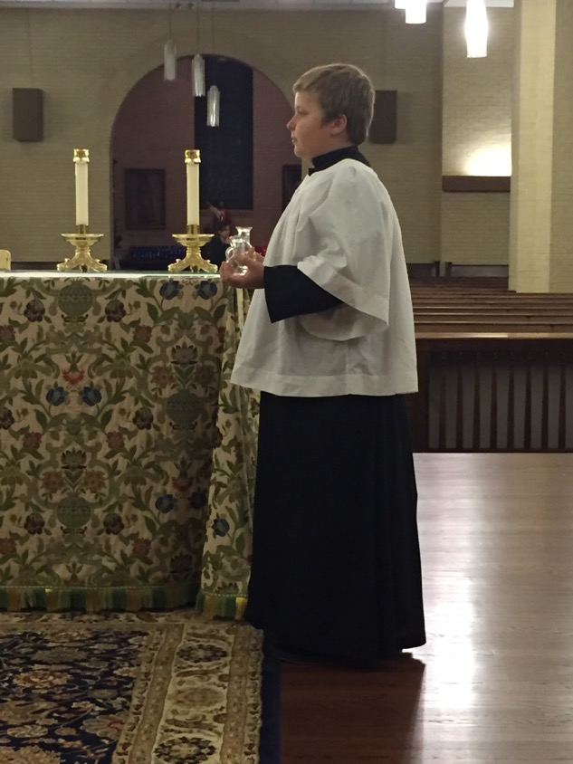
Where to stand
When serving the Celebrant, the Servers should stand just off the rug on which the Celebrant is standing. Stand parallel to the edge of the rug and wait for the Celebrant to come to you.

Slide 10
New Bell Procedures Beginning November 28
Still eight rings: First at the Epiclesis, Three at the Consecration of the Body, Three at the Consecration of the Blood, one when the Celebrant drinks the Precious Blood
The Consecration rings now happen as three, same length rings, after the Host or the Chalice is elevated, with a 1-2 second pause between rings

Slide 11
Epiclesis Bells

Slide 12
Consecration Bells

Slide 13
End of Mass
Process down the aisle as normal, but pause at the rear of the Church near the confessionals
The Celebrant will face the Crucifix, and say “Prosit”
The Servers will respond “Pro Omnibus et Singulis”

Slide 14
Reverencing the Cross

